Slide 1
Setting up Anaconda and Jupyter Notebook

Slide 2

https://www.anaconda.com/download/

Slide 3
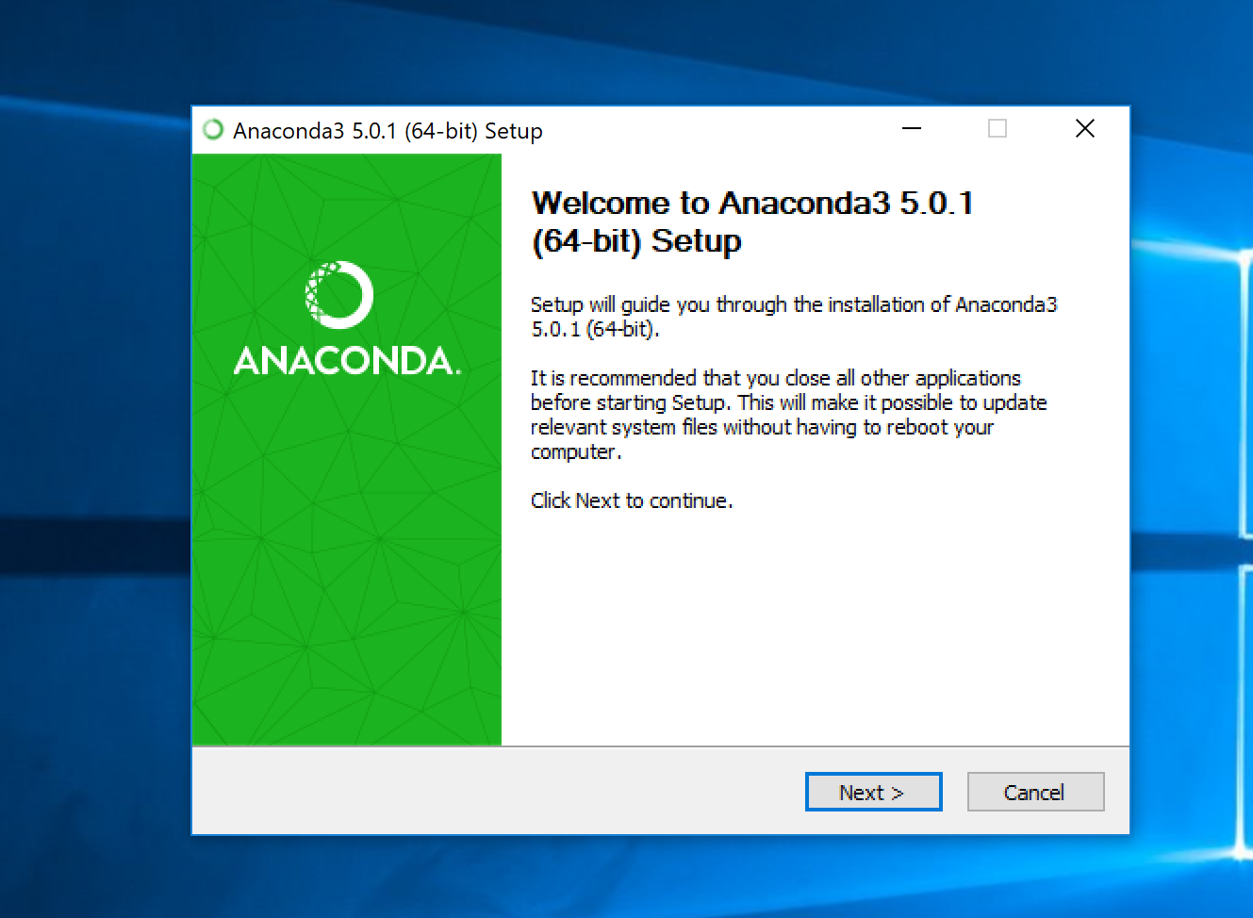
Installing..

Slide 4
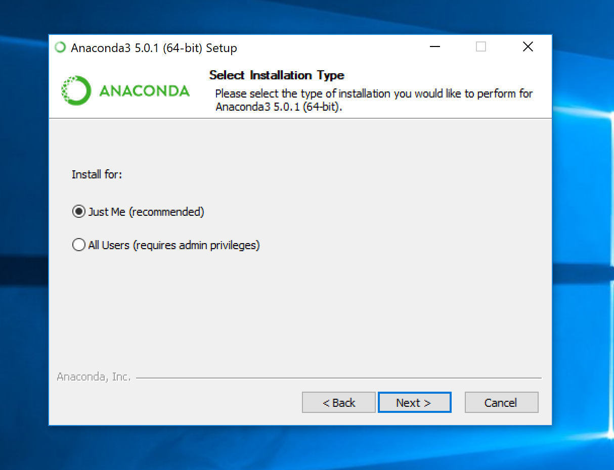
Installing..

Slide 5
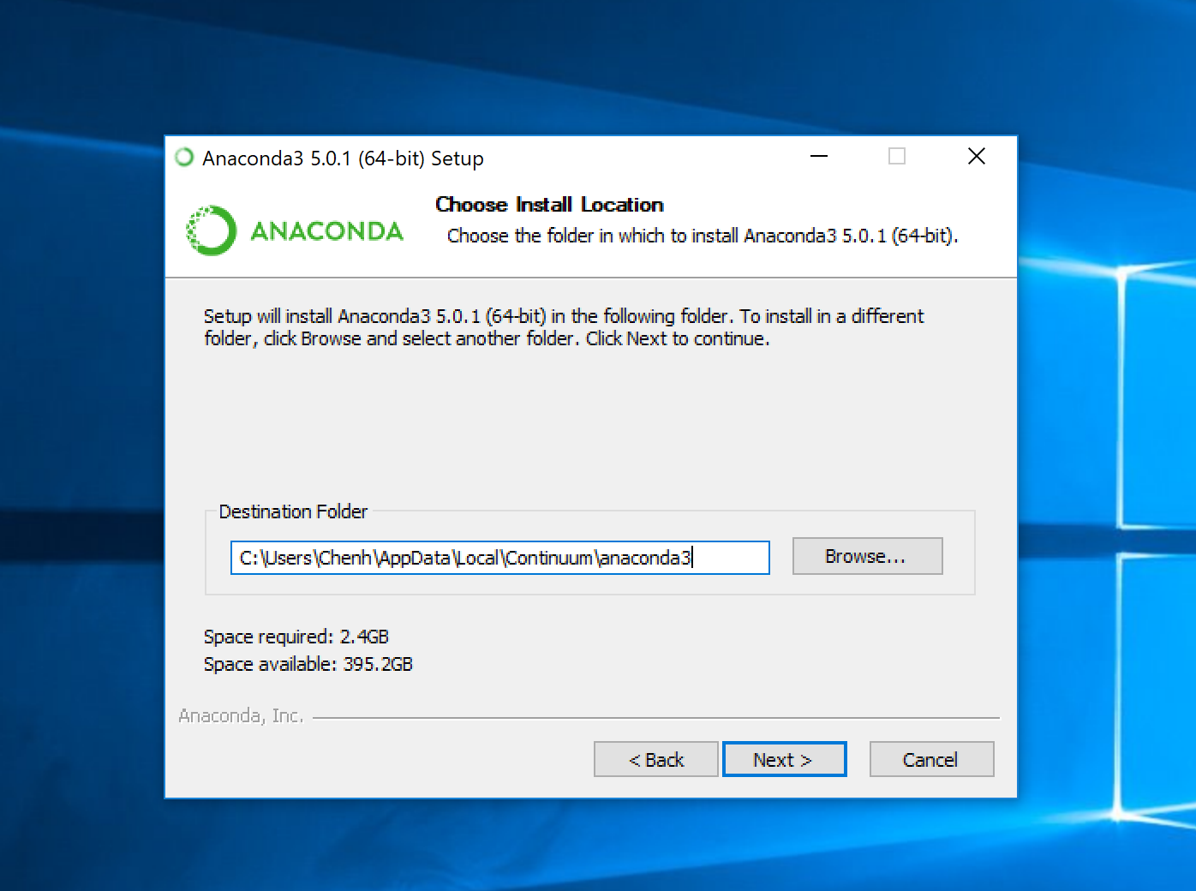
Installing..

Slide 6
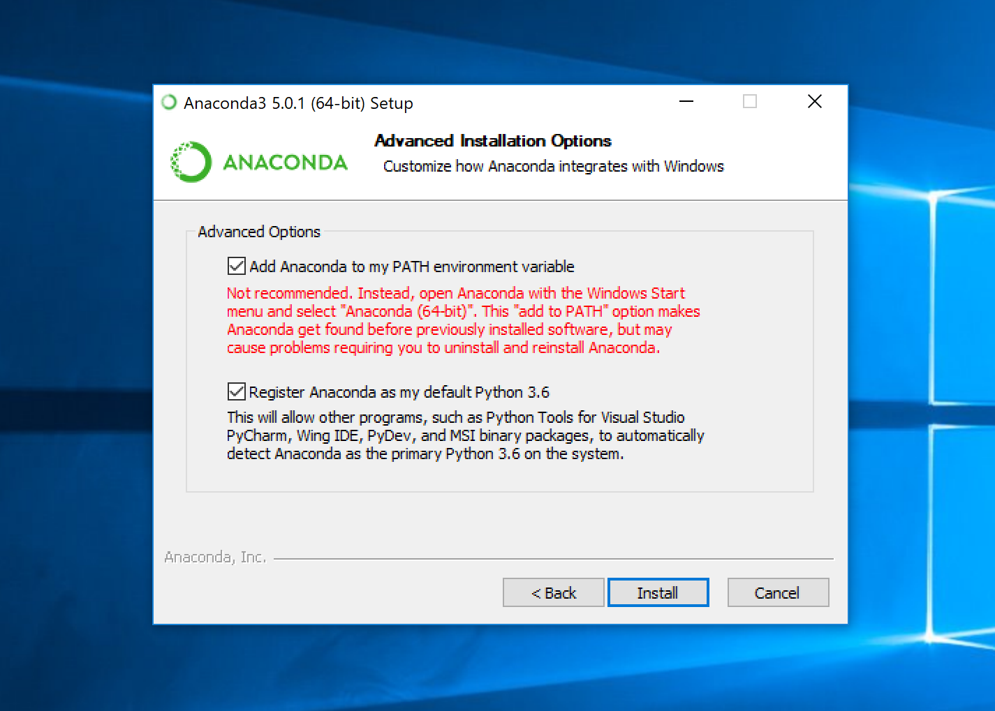
Important: Add anaconda to the PATH environment variable

Slide 7
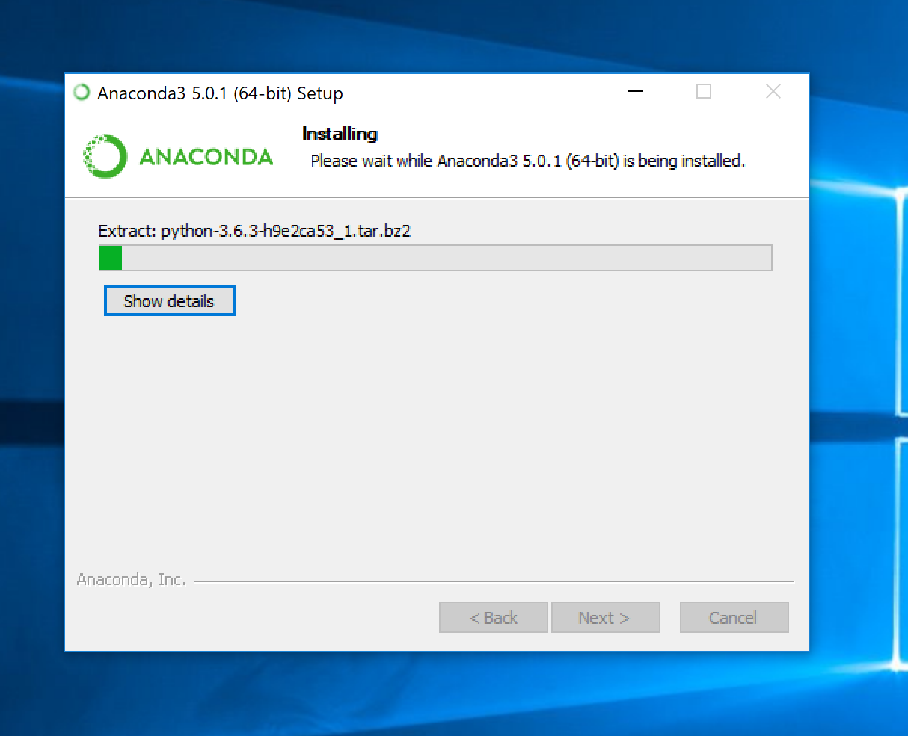
Installing..

Slide 8
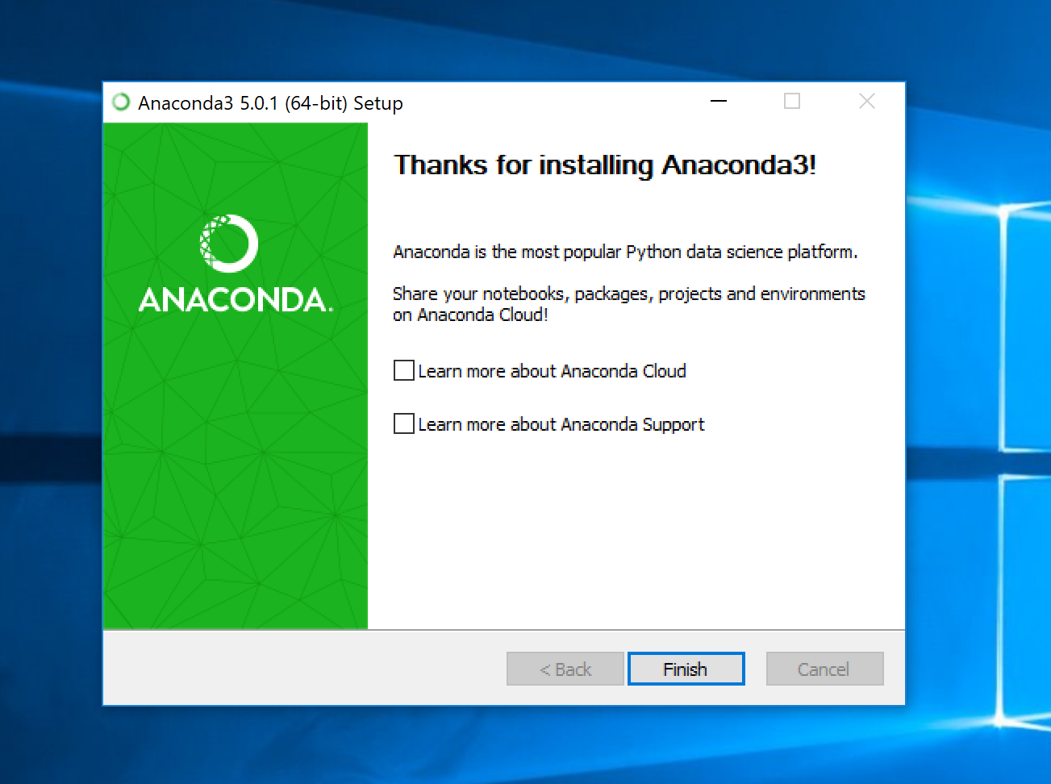
Finished

Slide 9
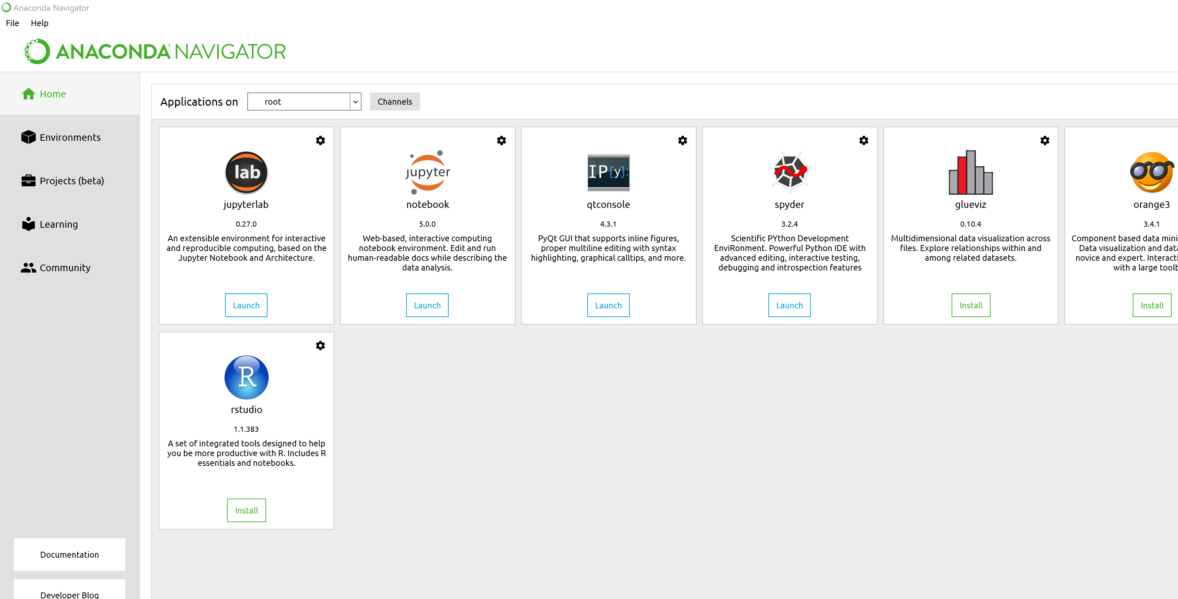
Launch navigator in start menu

Slide 10

Jupyter notebook

Slide 11
What Is A Jupyter Notebook
A document that allows you to mix both code and rich text elements, such as figures, links, equations, together in one place.
Jupyter notebooks provide interactive Python shell for you to run Python code.
Great for data analysis, visualization, and sharing code among people.
Files with extension .ipynb

Slide 12
Jupyter comes with Anaconda

Slide 13
How to open Jupyter notebooks (option 1)
Launch navigator in start menu
Launch Jupyter

Slide 14
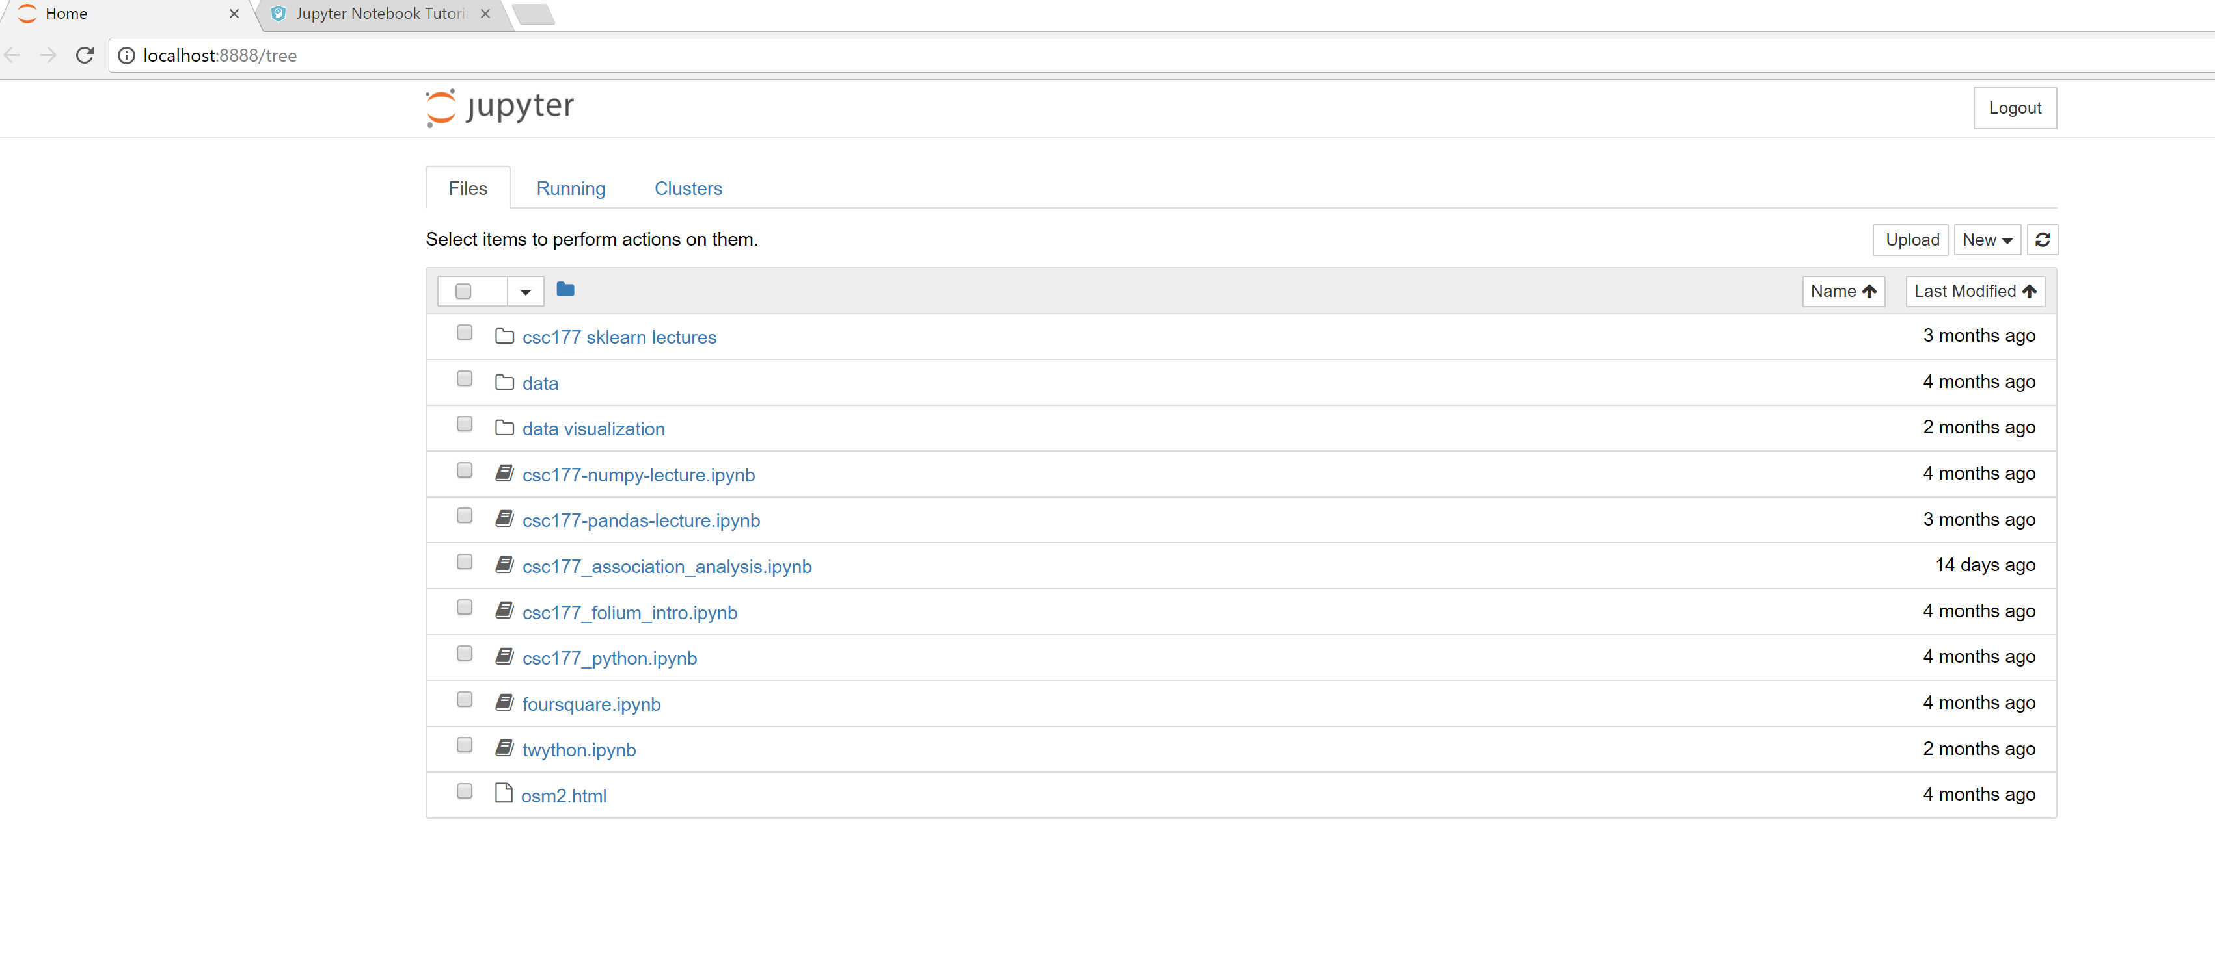
Then you'll see the application running in the web browser on the address: http://localhost:8888.

Slide 15
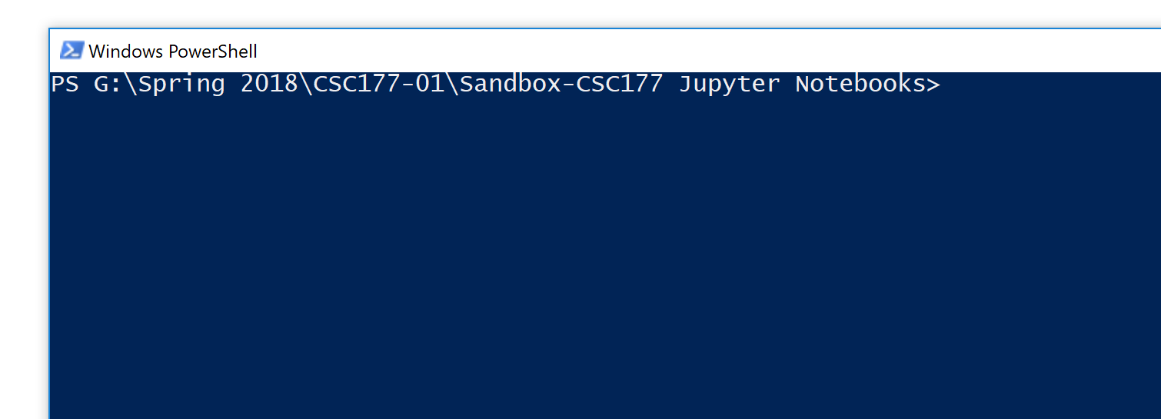
How To Open Jupyter Notebooks (option 2)
Go to the folder where your notebook is in.
Open CLI
E.g., on Windows, shift + right click, then select “open Powershell window”
Run the following command to open up the application:
jupyter notebook

Slide 16
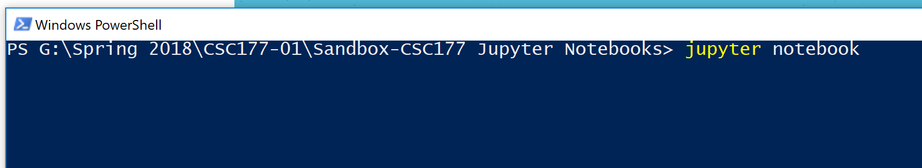
How To Open Jupyter Notebooks (option 2)

Slide 17
Then you'll see the application running in the web browser on the address: http://localhost:8888.

Slide 18
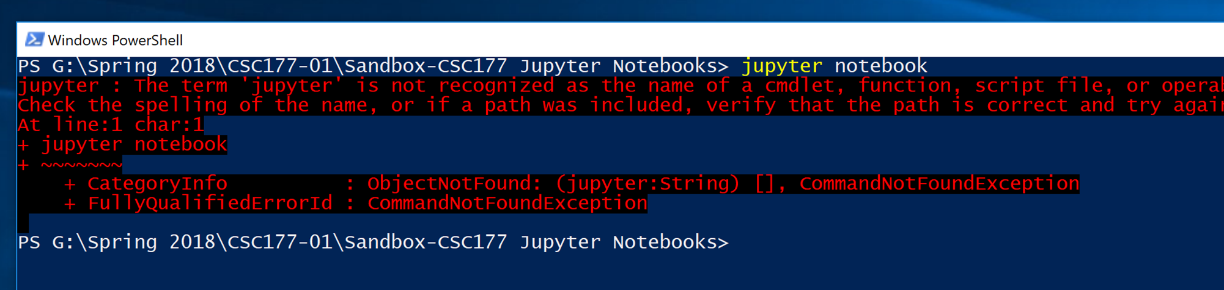
If you got this…

Slide 19
Make sure you added anaconda to PATH environment variable

Slide 20
Jupyter notebook has two types of cells
Code cell: where you run your Python code
Markdown cell: where you insert text/image/figure/audio/video

Slide 21
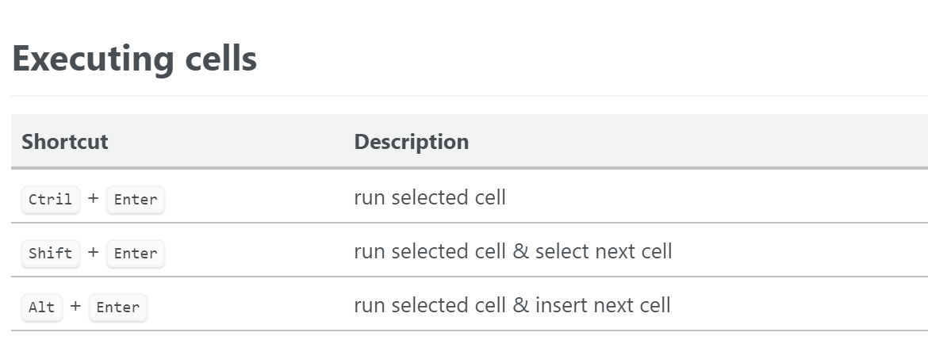
How to run each cell?

Slide 22
Each cell has two input modes
Each Jupyter notebook cell has two different keyboard input modes.
Edit mode allows you to type code/text into a cell and is indicated by a green cell border.
Command mode binds the keyboard to notebook level actions and is indicated by a grey cell border.

Slide 23
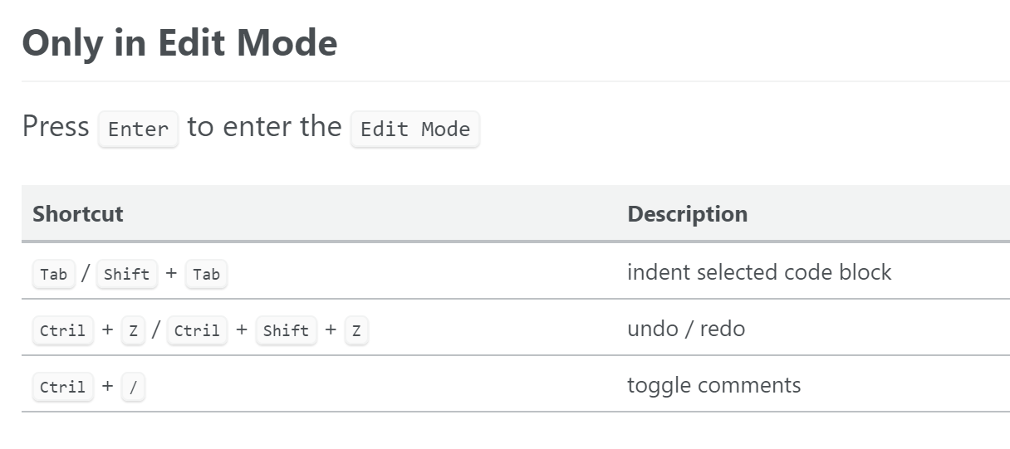
Keyboard shortcuts for edit mode

Slide 24
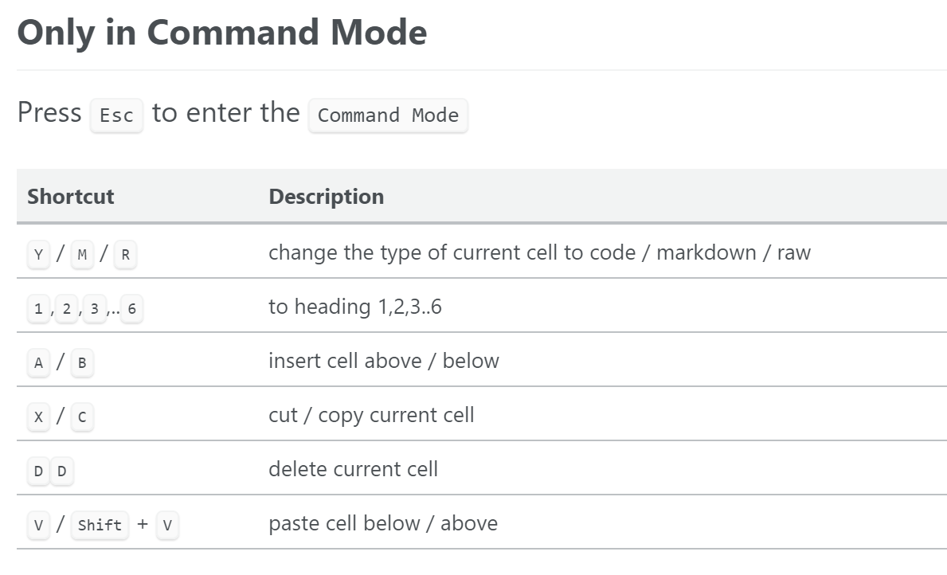
Keyboard shortcuts for command mode

